Slide 1

Workshop on C/C++
Day 2

Slide 2
Agenda
n Dimensional Arrays
Working with Strings
Pointers
User defined Functions
Logical Programming (Exercises)

Slide 3
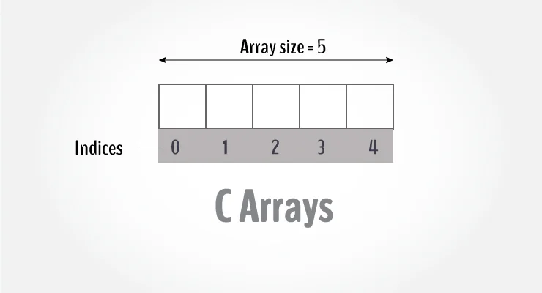
C Arrays
An array is a variable that can
store multiple values.
For example, if you
want to store 100 integers, you can
create an array for it.
int data[100];

Slide 4
C Arrays
How to declare an array?
dataType arrayName[arraySize];
For example, float mark[5];
Note – The size and type of an array cannot be changed once it is declared.

Slide 5
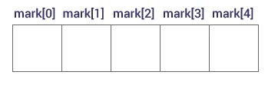
C Arrays
Access Array Elements
You can access elements of an
array by indices.
The first element is mark[0], the
second element is mark[1] and so on.
Arrays have 0 as the first index, not 1.
If the size of an array is n, to access the last element, the n-1 index is used.

Slide 6
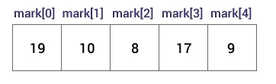
C Arrays
How to initialize an array?
int mark[5] = {19, 10, 8, 17, 9};
You can also initialize an array
like this.
int mark[] = {19, 10, 8, 17, 9};

Slide 7
C Arrays
Access elements out of its bound!
Suppose you declared an array of 10 elements. Let's say,
int testArray[10];
If you try to access testArray[12]. The element is not available.
This may cause unexpected output (undefined behavior).
Sometimes you might get an error and some other time your program may run correctly.

Slide 8
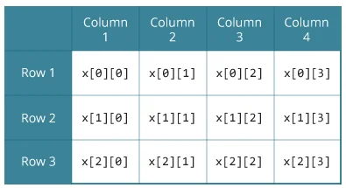
C Arrays
C Multidimensional Arrays
You can create an array of arrays.
These arrays are known as
multidimensional arrays.
For example,
float x[3][4];
Here, x is a two-dimensional (2d) array.
The array can hold 12 elements.
It is a table with 3 rows and each row has 4 columns.

Slide 9
C Arrays
Initializing a multidimensional array
Initialization of a 2d array
// Different ways to initialize two-dimensional array
int c[2][3] = {{1, 3, 0}, {-1, 5, 9}};
int c[][3] = {{1, 3, 0}, {-1, 5, 9}};
int c[2][3] = {1, 3, 0, -1, 5, 9};

Slide 10
C Arrays
Initializing a multidimensional array
Initialization of a 3d array
int test[2][3][4] = {
{{3, 4, 2, 3}, {0, -3, 9, 11}, {23, 12, 23, 2}},
{{13, 4, 56, 3}, {5, 9, 3, 5}, {3, 1, 4, 9}}};

Slide 11

C Strings
A string is a sequence of characters
terminated with a null character \0.
For example:
char c[] = "c string";
When the compiler encounters a
sequence of characters enclosed in
the double quotation marks, it appends
a null character \0 at the end by default.

Slide 12

C Strings
How to declare a string?
char s[5];

Slide 13

C Strings
How to initialize strings?
char c[] = "abcd";
char c[50] = "abcd";
char c[] = {'a', 'b', 'c', 'd', '\0'};
char c[5] = {'a', 'b', 'c', 'd', '\0'};

Slide 14
C Strings
Read String from the user
The scanf() function reads the sequence of characters until it encounters whitespace (space, newline, tab, etc.).
#include <stdio.h>
int main()
{
char name[20];
printf("Enter name: ");
scanf("%s", name);
printf("Your name is %s.", name);
return 0;
}

Slide 15
C Strings
How to read a line of text?
We can use the fgets() function to read a line of string. And, use puts() to display the string.
#include <stdio.h>
int main()
{
char name[30];
printf("Enter name: ");
fgets(name, sizeof(name), stdin); // read string
printf("Name: ");
puts(name); // display string
return 0;
}

Slide 16
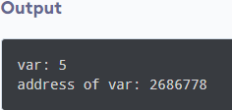
C Pointers
Address in C
If you have a variable var in your program, &var will give you its address in the memory.
Example:
#include <stdio.h>
int main()
{
int var = 5;
printf("var: %d\n", var);
// Notice the use of & before var
printf("address of var: %p", &var);
return 0;
}

Slide 17
C Pointers
Pointers (pointer variables) are special variables that are used to store addresses rather than values.
Pointer Syntax
We can declare pointers in the following way:
int* p;
Here, we have declared a pointer p of int type.
We can also declare pointers in these ways.
int *p1;
int * p2;

Slide 18
C Pointers
Assigning addresses to Pointers
int* pc, c;
c = 5;
pc = &c;
Here, 5 is assigned to the c variable. And, the address of c is assigned to the pc pointer.

Slide 19
C Pointers
Get Value of Thing Pointed by Pointers
To get the value of the thing pointed by the pointers, we use the * operator.
For example:
int* pc, c;
c = 5;
pc = &c;
printf("%d", *pc); // Output: 5
Here, the address of c is assigned to the pc pointer.
To get the value stored in that address, we used *pc.
* is called the dereference operator (when working with pointers).
It operates on a pointer and gives the value stored in that pointer.

Slide 20
C Pointers
Changing Value Pointed by Pointers
int* pc, c;
c = 5;
pc = &c;
c = 1;
printf("%d", c); // Output: 1
printf("%d", *pc); // Output: 1
We have assigned the address of c to the pc pointer.
Then, we changed the value of c to 1.
Since pc and the address of c is the same, *pc gives us 1.

Slide 21
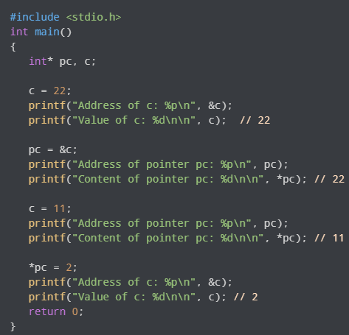
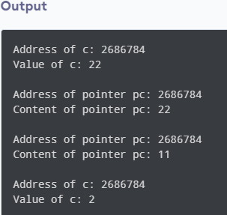
C Pointers
Working of Pointers

Slide 22
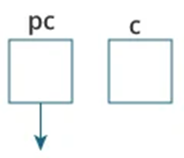
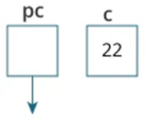
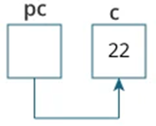
C Pointers
Explanation of the program
int* pc, c;
c = 22;
pc = &c;

Slide 23
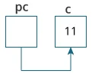
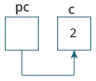
C Pointers
Explanation of the program
c = 11;
*pc = 2;

Slide 24
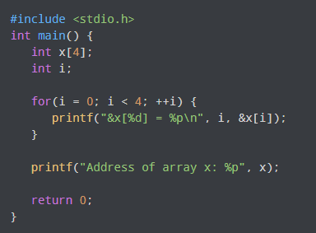
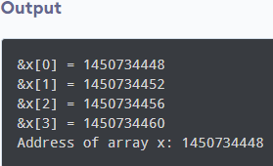
Relationship Between Arrays and Pointers
Program to print addresses of array elements.

Slide 25
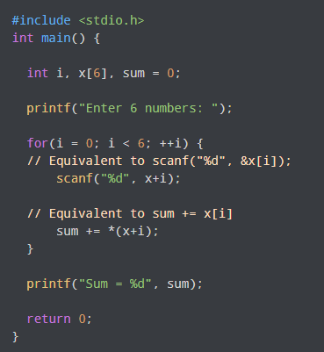
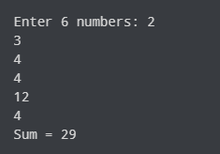
Pointers and Arrays
Example 1 Output

Slide 26
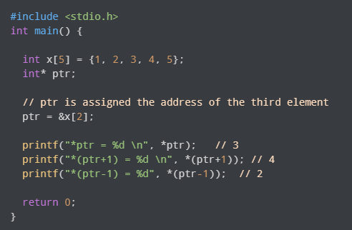

Pointers and Arrays
Example 2 Output

Slide 27
C Functions
A function is a block of code that performs a specific task.
Dividing a complex problem into smaller chunks makes our program easy to understand and reuse.
Types of function
There are two types of function in C programming:
Standard library functions
User-defined functions

Slide 28
C Functions
Standard library functions
The standard library functions are built-in functions in C programming.
These functions are defined in header files.
For example,
The printf() is a standard library function to send formatted output to the screen (display output on the screen). This function is defined in the stdio.h header file.
The sqrt() function calculates the square root of a number. The function is defined in the math.h header file.

Slide 29
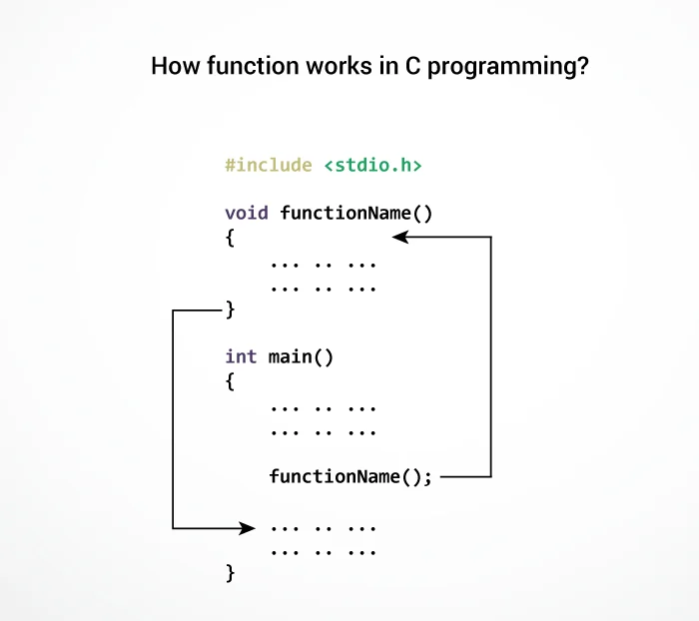
C Functions
User-defined function
You can also create functions
as per your need.
Such functions created by the
user are known as user-defined
functions.
Note: function names are
identifiers and should be unique.

Slide 30
C Functions
Advantages of user-defined function
The program will be easier to understand, maintain and debug.
Reusable codes that can be used in other programs
A large program can be divided into smaller modules.
Hence, a large project can be divided among many programmers.

Slide 31
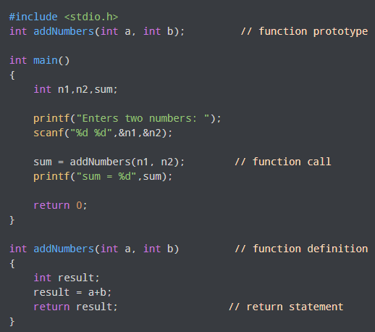
C Functions
User-defined functions
An example to add two integers.

Slide 32
C Functions
Function prototype
A function prototype is simply the declaration of a function that specifies function's name, parameters and return type.
It doesn't contain function body.
A function prototype gives information to the compiler that the function may later be used in the program.
Syntax of function prototype
returnType functionName(type1 argument1, type2 argument2, ...);

Slide 33
C Functions
Calling a function
Control of the program is transferred to the user-defined function by calling it.
Syntax of function call
functionName(argument1, argument2, ...);

Slide 34
C Functions
Function definition
Function definition contains the block of code to perform a specific task.
Syntax of function definition
returnType functionName(type1 argument1, type2 argument2, ...)
{
//body of the function
}

Slide 35
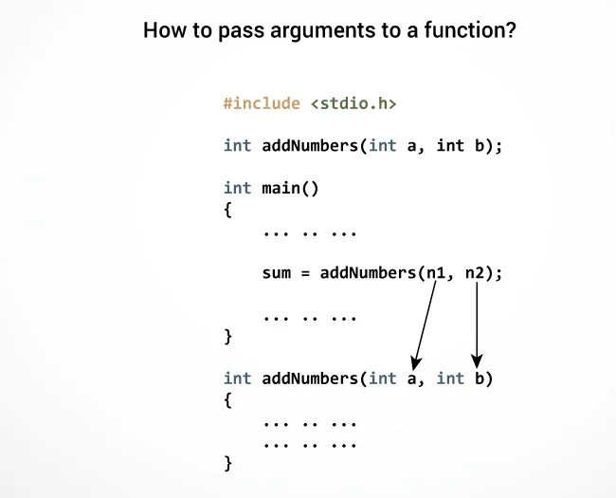
C Functions
Passing arguments to a function
The type of arguments passed
to a function and the formal
parameters must match,
otherwise, the compiler will
throw an error.

Slide 36
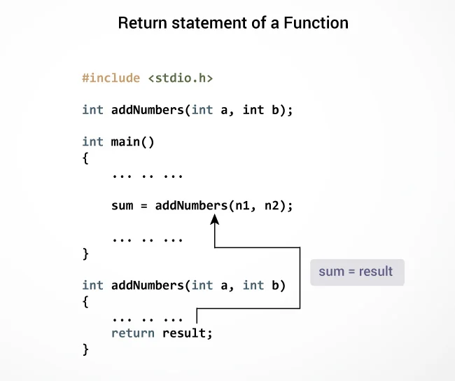
C Functions
Return Statement
The return statement terminates
the execution of a function and
returns a value to the calling
function. The program control is
transferred to the calling function
after the return statement.

Slide 37
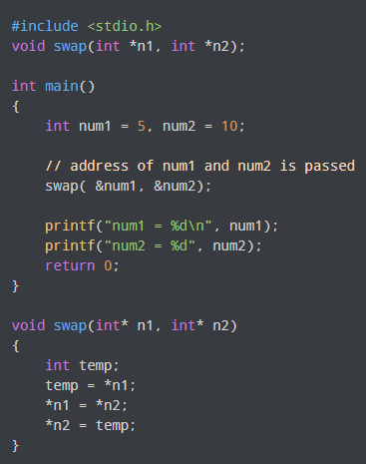

Pass Addresses and Pointers to functions
Pass Addresses to Functions
Output

Slide 38
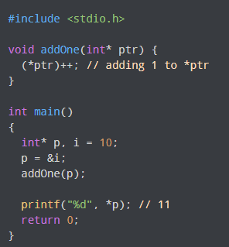
Pass Addresses and Pointers to functions
Passing Pointers to Functions

Slide 39
C Dynamic Memory Allocation
Once the size of an array is declared, you cannot change it.
Sometimes the size of the array you declared may be insufficient.
To solve this issue, we can allocate memory manually during run-time.
This is known as dynamic memory allocation in C programming.

Slide 40
C Dynamic Memory Allocation
malloc()
The name "malloc" stands for memory allocation.
The malloc() function reserves a block of memory of the specified number of bytes.
And, it returns a pointer of void which can be casted into pointers of any form.
Example:
ptr = (float*) malloc(100 * sizeof(float));
Allocates 400 bytes of memory.

Slide 41
C Dynamic Memory Allocation
calloc()
The name "calloc" stands for contiguous allocation.
The malloc() function allocates memory and leaves the memory uninitialized,
Whereas the calloc() function allocates memory and initializes all bits to zero.
Example:
ptr = (float*) calloc(25, sizeof(float));
The above statement allocates contiguous space in memory for 25 elements of type float.

Slide 42
C Dynamic Memory Allocation
free()
Dynamically allocated memory created with either calloc() or malloc() doesn't get freed on their own.
We must explicitly use free() to release the space.
Syntax of free()
free(ptr);
This statement frees the space allocated in the memory pointed by ptr.

Slide 43
C Dynamic Memory Allocation
realloc()
If the dynamically allocated memory is insufficient or more than required,
we can change the size of previously allocated memory using the realloc() function.
Syntax of realloc()
ptr = realloc(ptr, x);
Here, ptr is reallocated with a new size x.

Slide 44
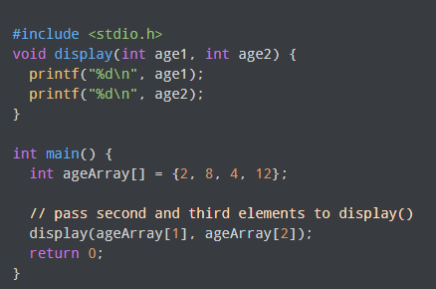
Pass arrays to a function in C
Pass Individual Array Elements

Slide 45
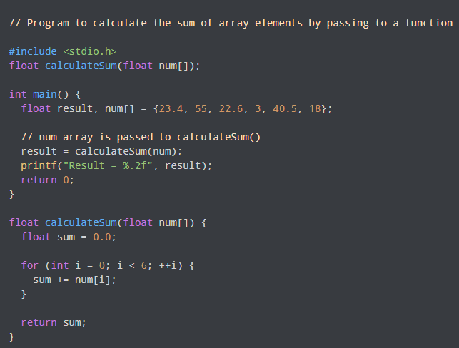
Pass arrays to a function in C
Pass Arrays to Functions

Slide 46
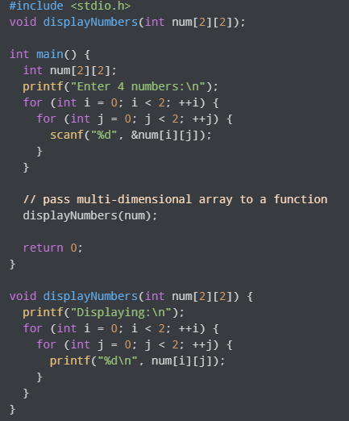
Pass arrays to a function in C
Pass Multidimensional Arrays to a Function
To pass multidimensional arrays
to a function, only the name of the
array is passed to the function
(similar to one-dimensional arrays).

Slide 47
C String Functions
Few commonly used string handling functions are:
Function Work of Function
strlen() computes string's length
strcpy() copies a string to another
strcat() concatenates(joins) two strings
strcmp() compares two strings
strlwr() converts string to lowercase
strupr() converts string to uppercase

Slide 48


Slide 49

Please contact
Foundation for Innovation and Collaborative
Education
mentor@fice.in
www.fice.in
Please contact
Foundation for Innovation and Collaborative
Education
info@fice.in
mentor@fice.in
Notes:
Here are the lessons we are going to learn today.

